Slide 1
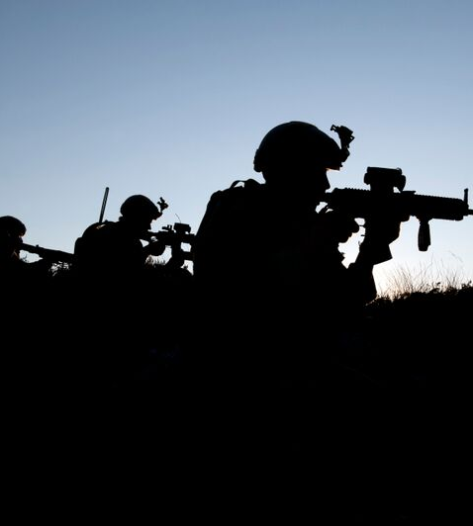

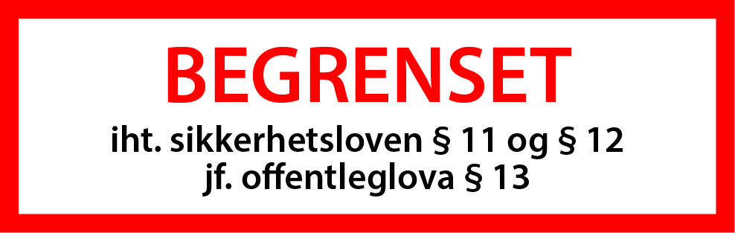

Grunnleggende VMS systemdrift

Slide 2






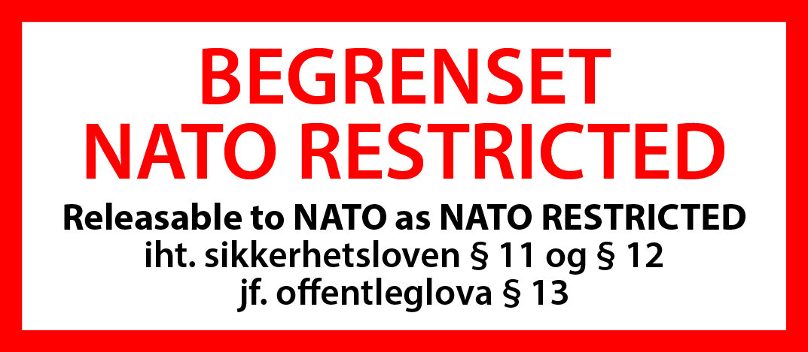
Til 1. lysbildet
Til øvrige lysbilder

Slide 3

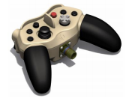
Grunnleggende systemdrift
Oppstart
  Ved oppstart av systemet, starter PC-en automatisk VMS, CMS og Skyperion Control Station
Kontroll av systemet
  VMS kan kontrolleres på følgende måter:
    Håndkontrollen – Manuelt styre EOD og kamerafunksjoner
    Via CMS-en – Dersom det er valgt fra CMS
    Vanlig datamus – Bruke on-screen knapper og flytte kameraet

Slide 4
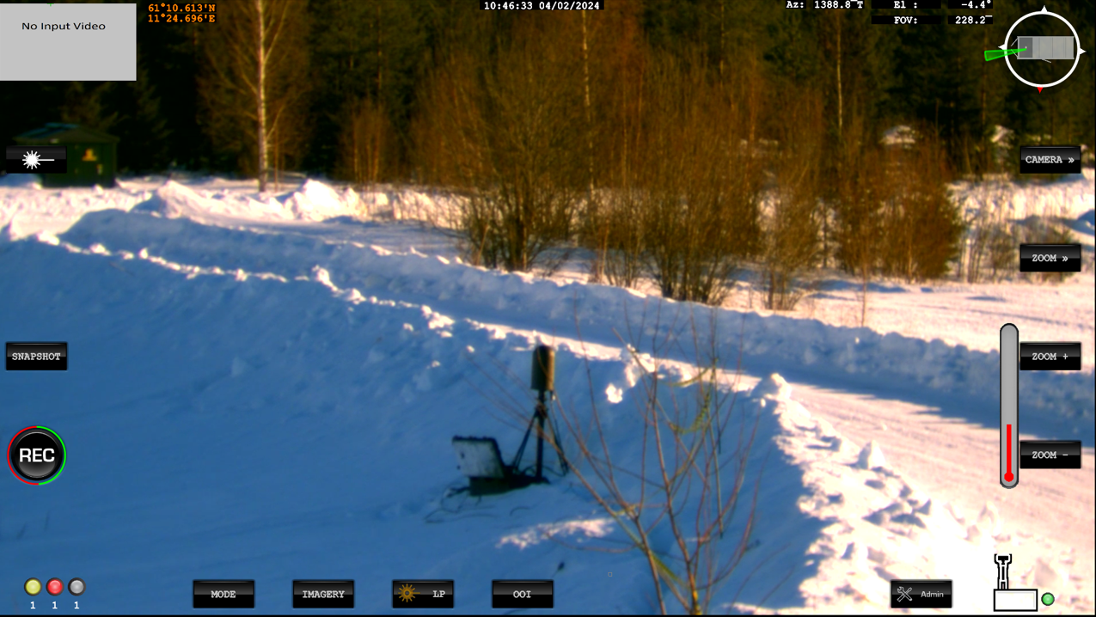
VMS display
Notes:
Top Middle: Date and Time – This is Zulu time (Not Norweigen)
Top Right: Current system AZ and EL angles including Active Camera FOV in Mils
Top Right: Compass / View of Camera direction in relation to the Container
Right: Control Selection
Right: Control Selection – Sub menu.
Right: Sub Menu controls.
Bottom right: Access to Admin Menu
Bottom: Modes, Imager, Laser Pointer and OOI (Objects of interest)
Mid Left: Video Recording and Image snapshot controls.
Very top left: Secondary Sensor Display. Selectable via Touch screen, F1 function Key
Top Left in Green: Lat/Long of the vehicle

Slide 5
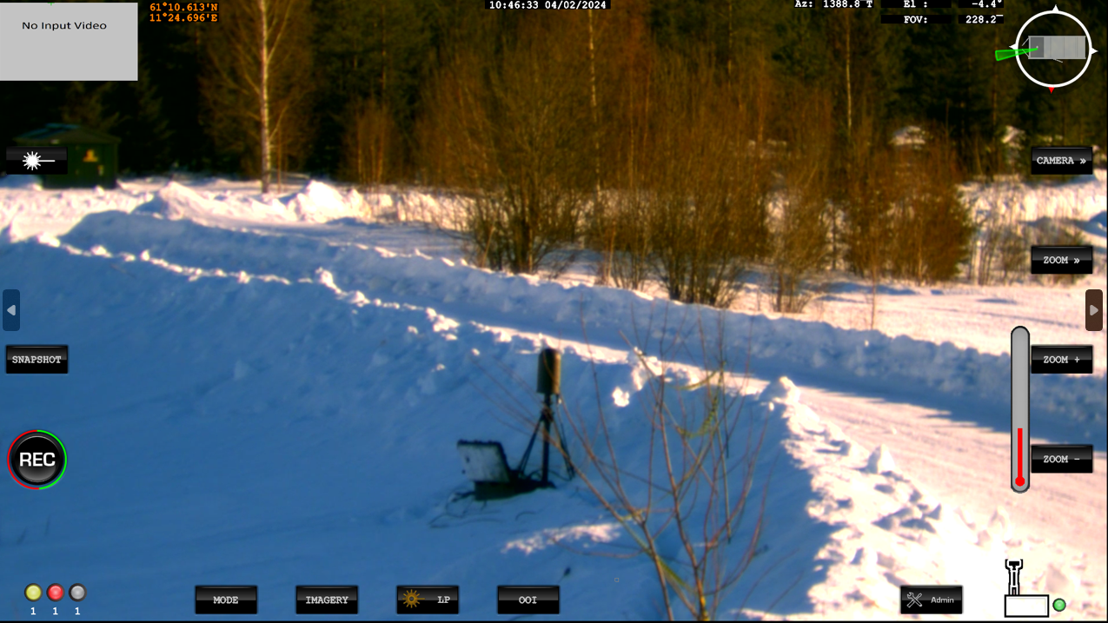
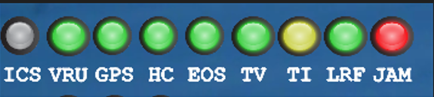
Sub-system indikatorer
Indicator | Description
ICS | Not Utilised on CUAS
VRU | Vertical Reference Unit (IMU)
GPS | Global Positioning Service
HC | Hand controller
EOS | Electro Optical System
TV | Television Camera
TI | Thermal Imaging Camera
LRF | Laser Range Finder
JAM | RF Defeat (Jammer)
Status Colour | Status
RED | Non-operational/faulty
YELLOW | Preparing for operation/no communication
GREEN | Operational
GREY | Not available

Slide 6






Valg av modus
Button | Mode | Description
 | Standby (STBY) | Commands the platform to standby with the brakes applied and the motors switched off. Press the button twice to power off the console.
 | Manual (MAN) | Releases the brakes and allows the EOD to be controlled.
 | Track (TRK) | Press once to enter manual (target acquisition) mode, during which the gamepad controller can be used to control the pointing angle of the EOD. Press again to select the tracking mode, which follows items selected by the user. This mode can be used with both TV and the TI cameras. The joystick can also be used to toggle between manual and track mode. Selects auto track mode where the EOD is controlled by the automatic video tracker.

Slide 7



Valg av modus
Button | Mode | Description
 | Park (PARK) | When pressed, the EOD is driven to its park position and put in standby mode. This is System 0 and not North Orientated
 | Gyro | This is disabled for CUAS and not selectable.
 | Jammer | This is used to access the Jammer control.

Slide 8






TV kamera kontroll
Camera control button | Description
 | Zooms in (narrows the camera’s field of view)
 | Zooms out (widens the camera’s field of view)
 | Focuses on a far object
 | Focuses on a near object
 | Sets the Camera to Auto Focus
 | Displays the camera image in Black and White using an IR cut filter

Slide 9
TI kamera kontroll
Camera control button | Description
 | Zooms in (narrows the camera’s field of view)
 | Zooms out (widens the camera’s field of view)
 | Focuses on a far object
 | Focuses on a near object
 | Sets the Camera to Auto Focus

Slide 10








TI kamera kontroll
Camera control button | Description
 | Performs a calibration of the Thermal Camera Image
 | Powers On/Off the Thermal Camera
 | Switches between White Hot and Black Hot Thermal camera images. A notification is shown for 5 Seconds when changed.
 | Allows adjustment of the Threshold parameters. This can be Incremented/Decremented/Auto
 | Allows adjustment of the Contrast of the image. This can be Incremented/Decremented/Auto
 | Allows adjustment of the Brightness of the image. This can be Incremented/Decremented/Auto
Notes:
Kan være lurt å skru av TI kamera når det ikke er i bruk. Intern kjølemotor har levetid.

Slide 11
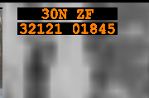
GPS
Gir følgende data:
  Containerposisjon
  Kommer fra GPS og kompass
  Kan bytte mellom LAT/LONG, MGRS og UTM i admin menyen

Slide 12
Oppsummering
Kjerneverdier og ledelse
Notes:
Bedre bilde av hva RAM innebærer i det daglige? Hvorfor?
Hva betyr oppdragsbasert ledelse for en stab
Tillit, hvordan gir man det? Hvordan utøver man kontroll?
Hva innebærer det å stille krav? Hvorfor er dette vanskelig?
Spørsmål?

